Slide 1
CARDIOVASCULAR DISEASE PREDICTION
Using Machine learning

Slide 2
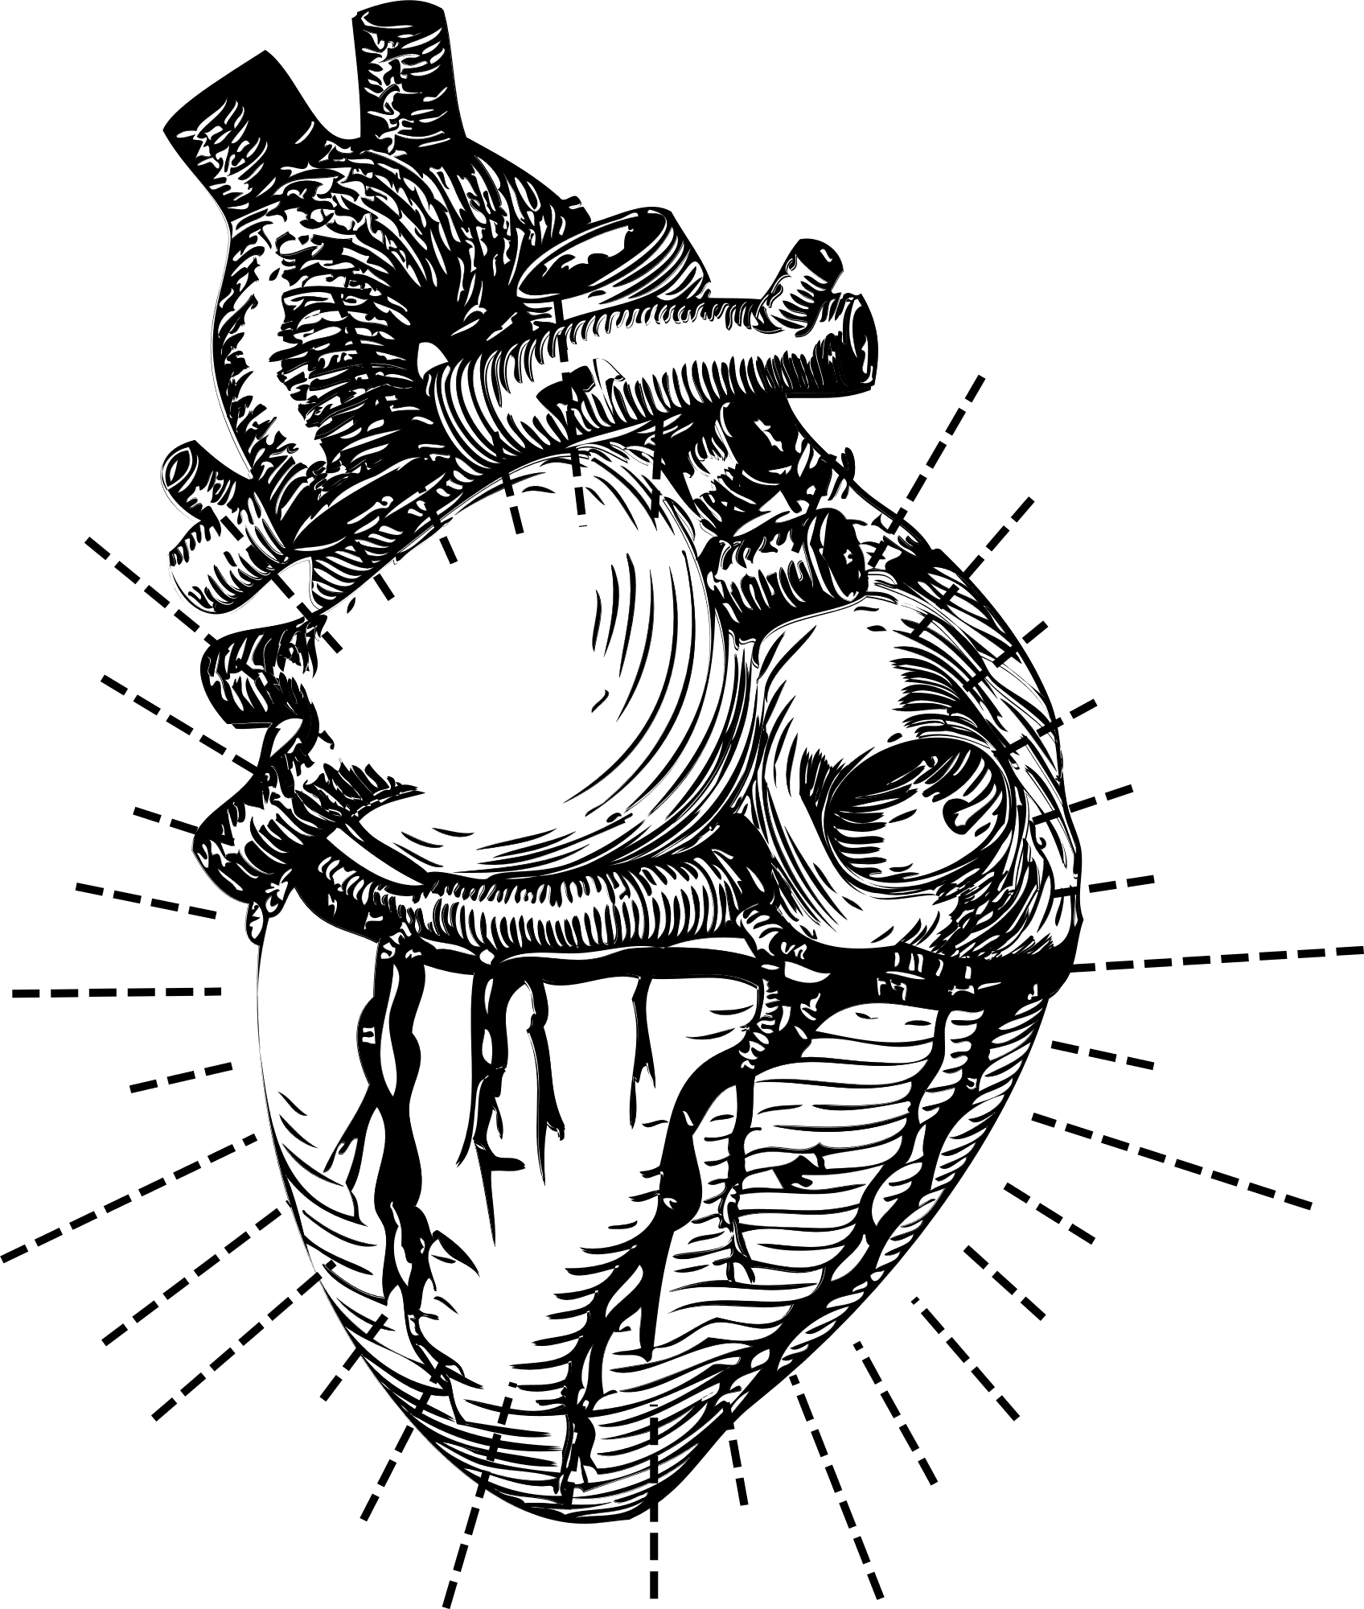
WHAT WE'LL DISCUSS TODAY
Cardiovascular Disease Guide
Introduction
Objective of study
Dataset Details
Tools & methods
Proposed system
Algorithm
Advantages
System Architecture
Requirements
Conclusion

Slide 3
LET'S GET
STARTED

Slide 4
About the Disease
Cardiovascular diseases (CVD) remain a leading cause of mortality worldwide, accounting for a substantial number of deaths each year. Early detection and timely intervention are crucial in preventing the onset of these diseases and reducing associated mortality rates. With the advancements in technology and the availability of vast amounts of healthcare data, predictive analytics has emerged as a powerful tool in the field of medicine. By harnessing the potential of machine learning algorithms and data analysis techniques, it is possible to predict the risk of cardiovascular diseases in individuals, enabling healthcare professionals to make informed decisions and implement preventive measures.
INTRODUTION

Slide 5

OBJECTIVES
Objective Of Study
Developing a cardiovascular disease prediction model using machine learning involves setting clear objectives to guide the research and development process. Here are some suggested objectives for your cardiovascular disease prediction project:
1. Data Collection and preparation
2. Feature Selection and Engineering
3. Data Analysis
4. Model Selection and Training
5. Testing of model
6. Real-time Prediction and Deployment
7. Continuous Monitoring and Model Updating
By setting these objectives, you can systematically approach the development of a cardiovascular disease prediction model using machine learning, ensuring accuracy, reliability, and ethical considerations throughout the process.

Slide 6
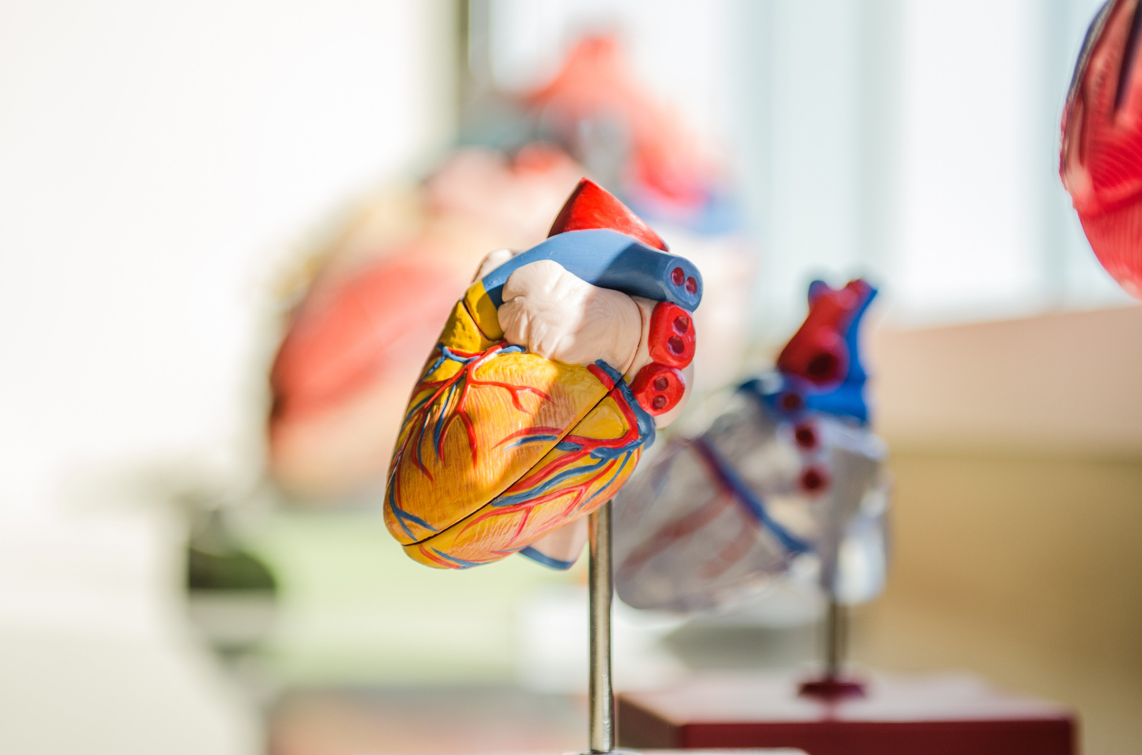
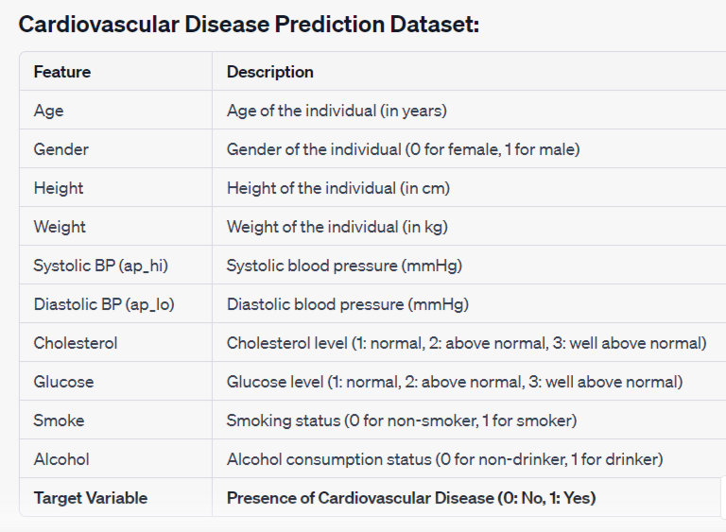
DATASET DETAILS

Slide 7

TOOLS & METHODS
Tools
Programming Languages:
Python: Python is a popular programming language for machine learning and data analysis.
Machine Learning Libraries:
Scikit-Learn: A comprehensive machine learning library in Python that provides simple and efficient tools for data mining and data analysis.
Data Visualization:
Matplotlib: A popular Python plotting library for creating static, interactive, and animated visualizations in Python.
Seaborn: Seaborn is based on Matplotlib and provides a high-level interface for creating attractive and informative statistical graphics.

Slide 8

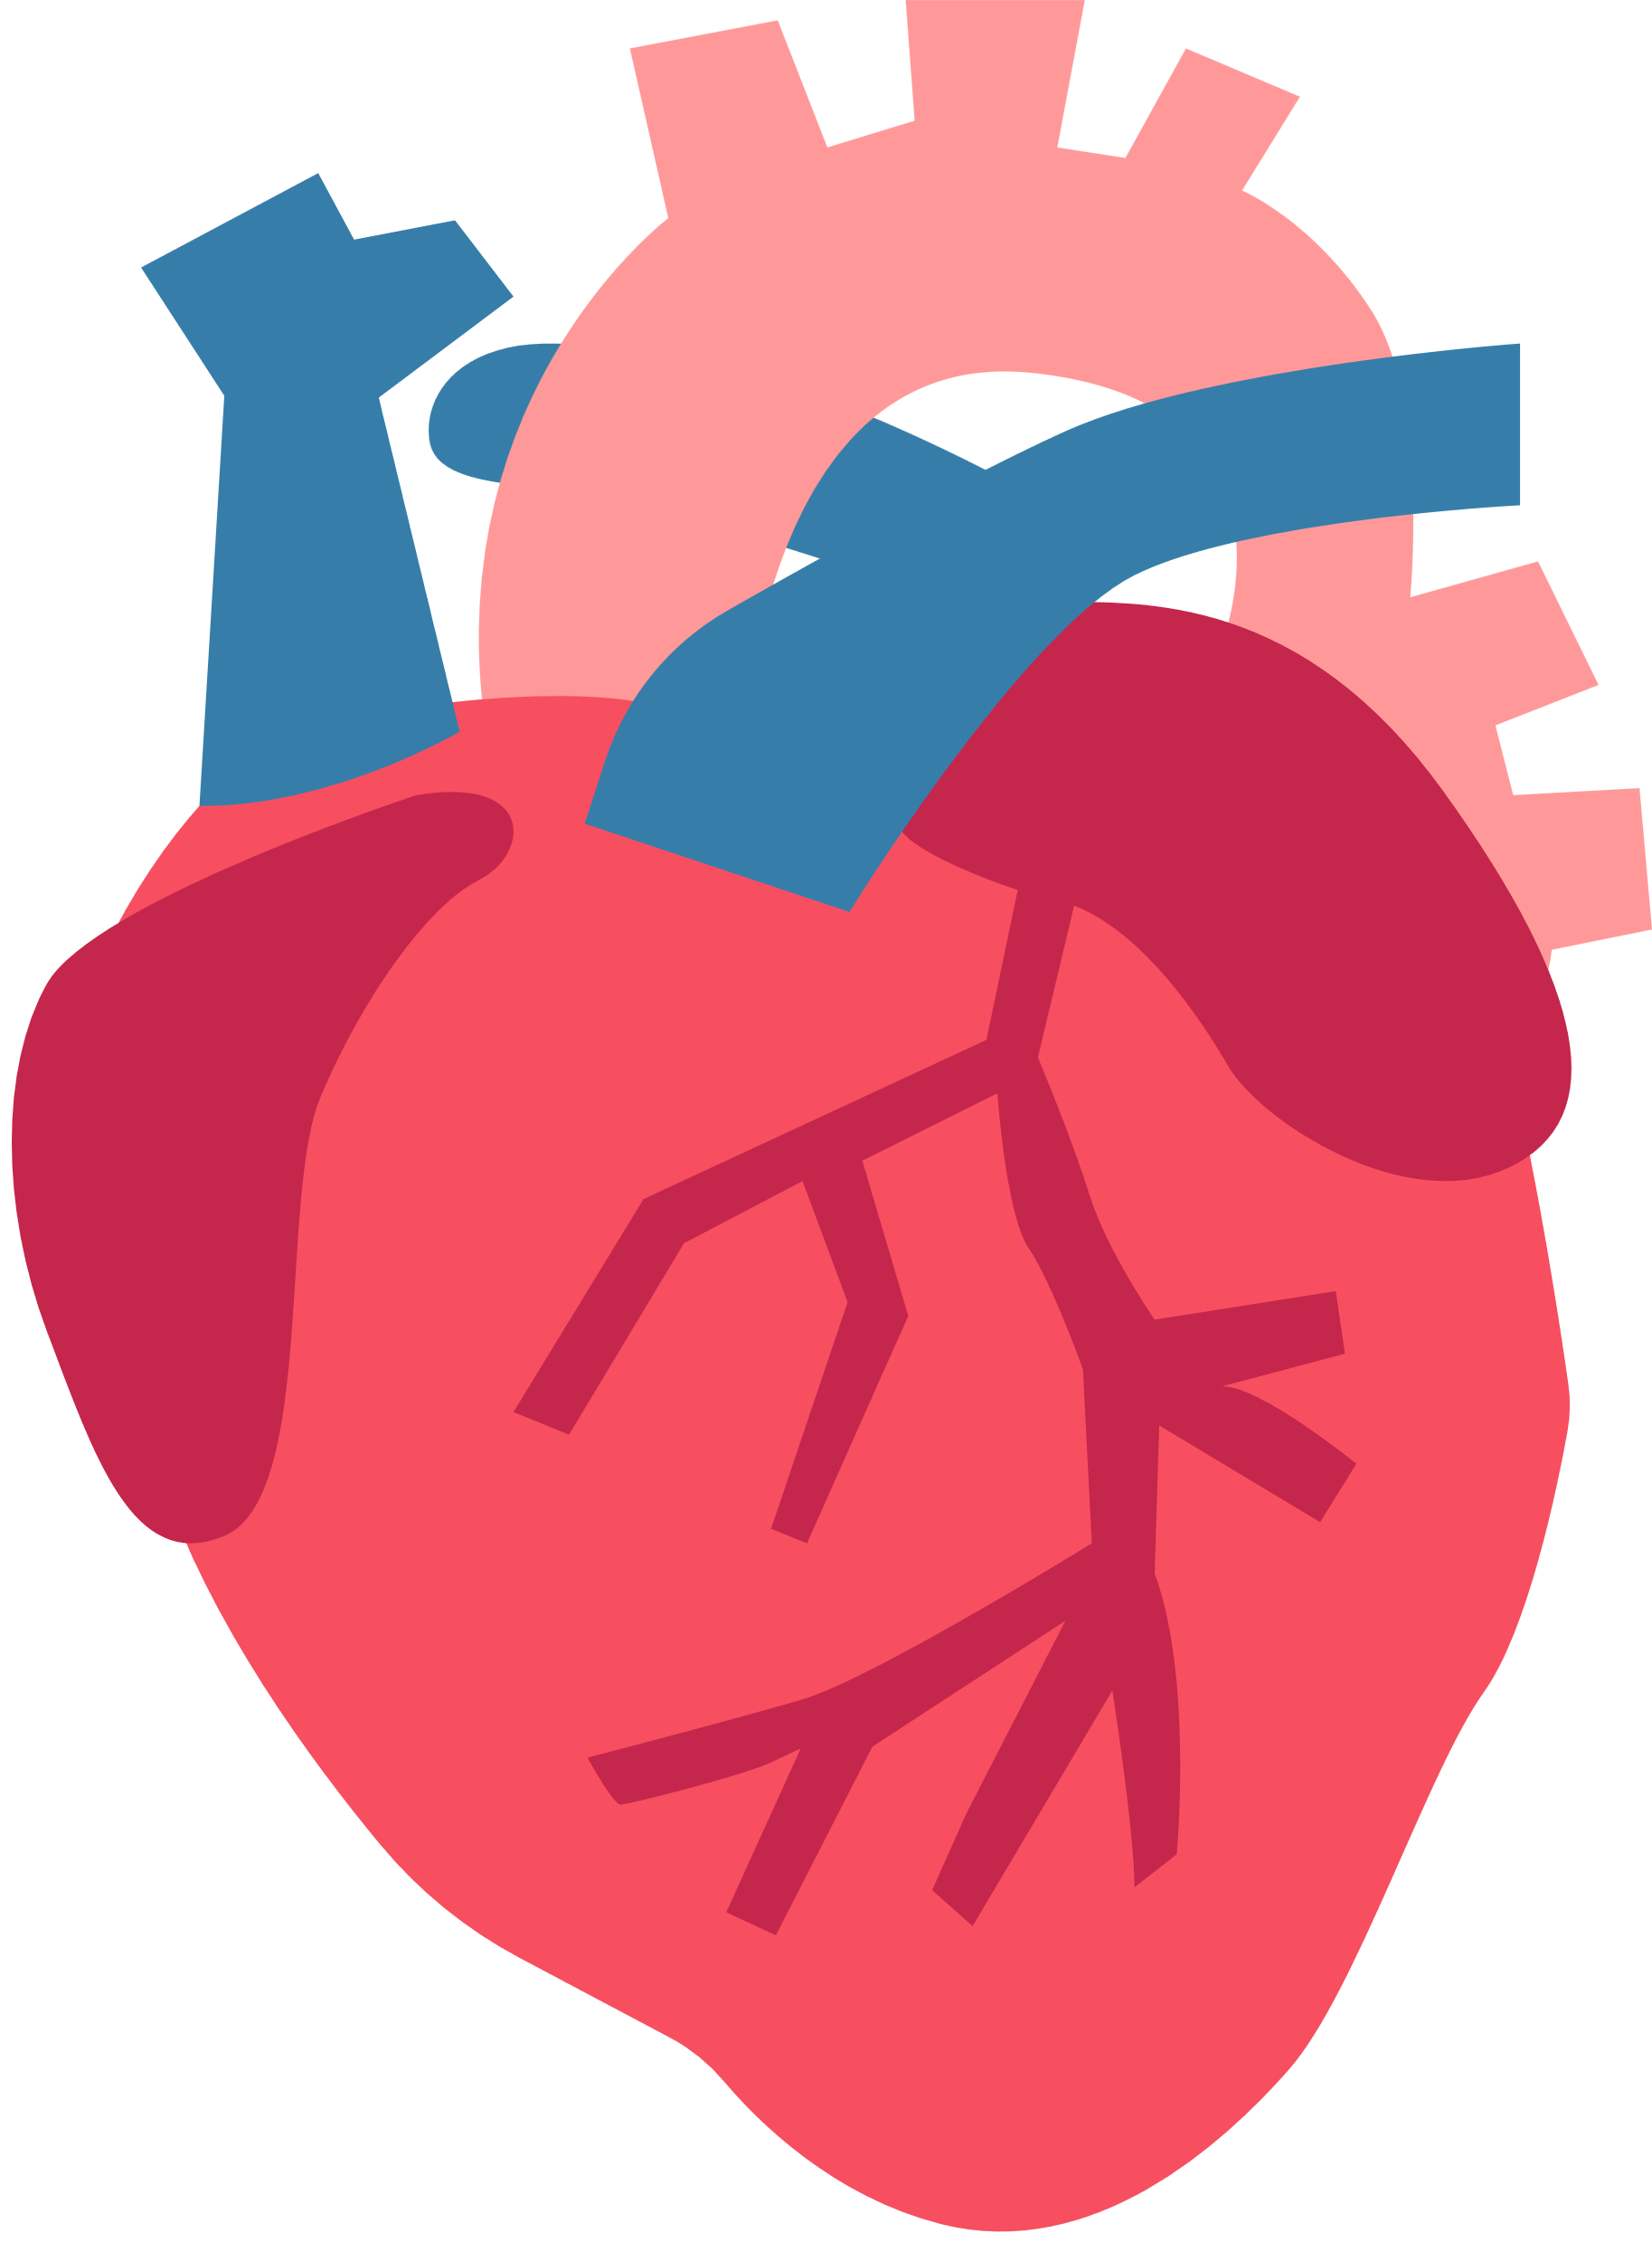
TOOLS & METHODS
Methods
1. Data Preprocessing:
Data Cleaning: Handling missing values, outliers, and irrelevant data points.
2.Feature Selection
3.Machine Learning Algorithms:
Logistic Regression: Suitable for binary classification tasks like predicting the presence or absence of cardiovascular diseases.
Random Forests: Effective for capturing complex relationships in the data.
Support Vector Machines (SVM): Useful for both linear and non-linear classification tasks.
K-Nearest Neighbors (KNN) is a simple, instance-based learning algorithm used for classification and regression tasks in machine learning.
4.Model Evaluation

Slide 9

PROPOSED SYSTEM
We have proposed a novel Machine Learning based Cardiovascular Disease Diagnosis Framework for the prediction of cardiovascular diseases. The objective of this presentation is to present an accurate machine learning model which can identify cardiovascular diseases reliably, based on the patients’ clinical parameters. We generate ML model based on previous data set after model training is performed and the trained model will then be used to make predictions. Our main aim is to get the improved results with reduced number of features / computational complexity.

Slide 10
ALGORITHMS
Machine learning Algorithms Used
Logistic Regression: Suitable for binary classification tasks like predicting the presence or absence of cardiovascular diseases.
Random Forests: Effective for capturing complex relationships in the data.
Support Vector Machines (SVM): Useful for both linear and non-linear classification tasks.
K-Nearest Neighbors (KNN) is a simple, instance-based learning algorithm used for classification and regression tasks in machine learning.

Slide 11
ADVANTAGES
1. Early Detection:
Cardiovascular disease prediction models can identify individuals at risk of developing heart diseases at an early stage, allowing for timely interventions and preventive measures.
2. Preventive Interventions:
Early prediction enables healthcare professionals to implement preventive interventions, such as lifestyle modifications, medication, and dietary changes, to reduce the risk of cardiovascular events like heart attacks and strokes.
3. Cost-Effectiveness:
Predictive models can potentially reduce healthcare costs by focusing resources on high-risk individuals, preventing expensive emergency treatments and hospitalizations related to cardiovascular events.
4. Personalized Medicine:
Predictive models can be tailored to individual patient profiles, allowing for personalized healthcare plans and interventions based on specific risk factors identified in each patient.
5. Improved Patient Outcomes:
By identifying high-risk patients, healthcare providers can offer targeted treatments and interventions, leading to improved patient outcomes and a reduction in morbidity and mortality rates.

Slide 12
ADVANTAGES
6. Population Health Management:
Cardiovascular disease prediction models can be applied at the population level, enabling public health authorities to identify high-risk regions or communities. This information can guide public health initiatives and resource allocation.
7. Reduced Burden on Healthcare System:
By preventing cardiovascular events in high-risk individuals, the burden on healthcare systems is reduced, leading to better allocation of resources and reduced strain on medical facilities.
8. Encourages Healthier Lifestyles:
Awareness of cardiovascular disease risk can motivate individuals to adopt healthier lifestyles, including regular exercise, balanced diet, and smoking cessation, further reducing the risk of heart diseases.
9. Research and Insights:
Data collected from cardiovascular disease prediction models can provide valuable insights for medical research, leading to a better understanding of risk factors and potential therapies.
10. Data-Driven Decision Making:
Predictive analytics allows healthcare providers and policymakers to make data-driven decisions, ensuring that resources are allocated efficiently and effectively to prevent cardiovascular diseases.

Slide 13
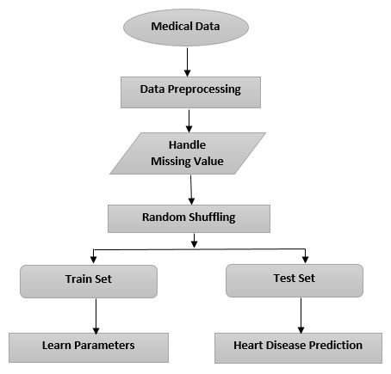
SYSTEM ARCHITECTURE
CDP

Slide 14
REQUIREMENTS
H/W Requirements
S/W Requirements
#Processor: Intel core i5
#RAM: 8 GB
#ROM: 256 GB
#OS: Windows OS
#Programming Lang.: Python
#Internet & Browsing facilities

Slide 15
In conclusion, learning machine learning techniques for cardiovascular disease prediction represents a significant advancement in healthcare. Through the analysis of diverse datasets and the application of sophisticated algorithms, these predictive models offer valuable insights and numerous benefits.
Machine learning models provide valuable feedback loops for continuous improvement. By analyzing outcomes and refining algorithms, researchers and healthcare providers can enhance the accuracy and effectiveness of predictive models over time. This iterative process drives
CONCLUSION

Slide 16
THANKS
FOR YOUR KIND ATTENTION !!

